Slide 1
Suicide Rate Analysis
BY
Jaimon Thyparambil Thomas

Slide 2
Introduction
Every Year Approximately 800000 people die
Approximately 1 person per second
For every suicide there is approx. 20 persons who attempted and failed
One of the most preventable cause of death compared to others

Slide 3
Questions
Analyse patterns based on age, sex, country etc.
Analyse the influence of GDP on suicide rates
Analyse the influence of Happiness rating on suicide rates

Slide 4
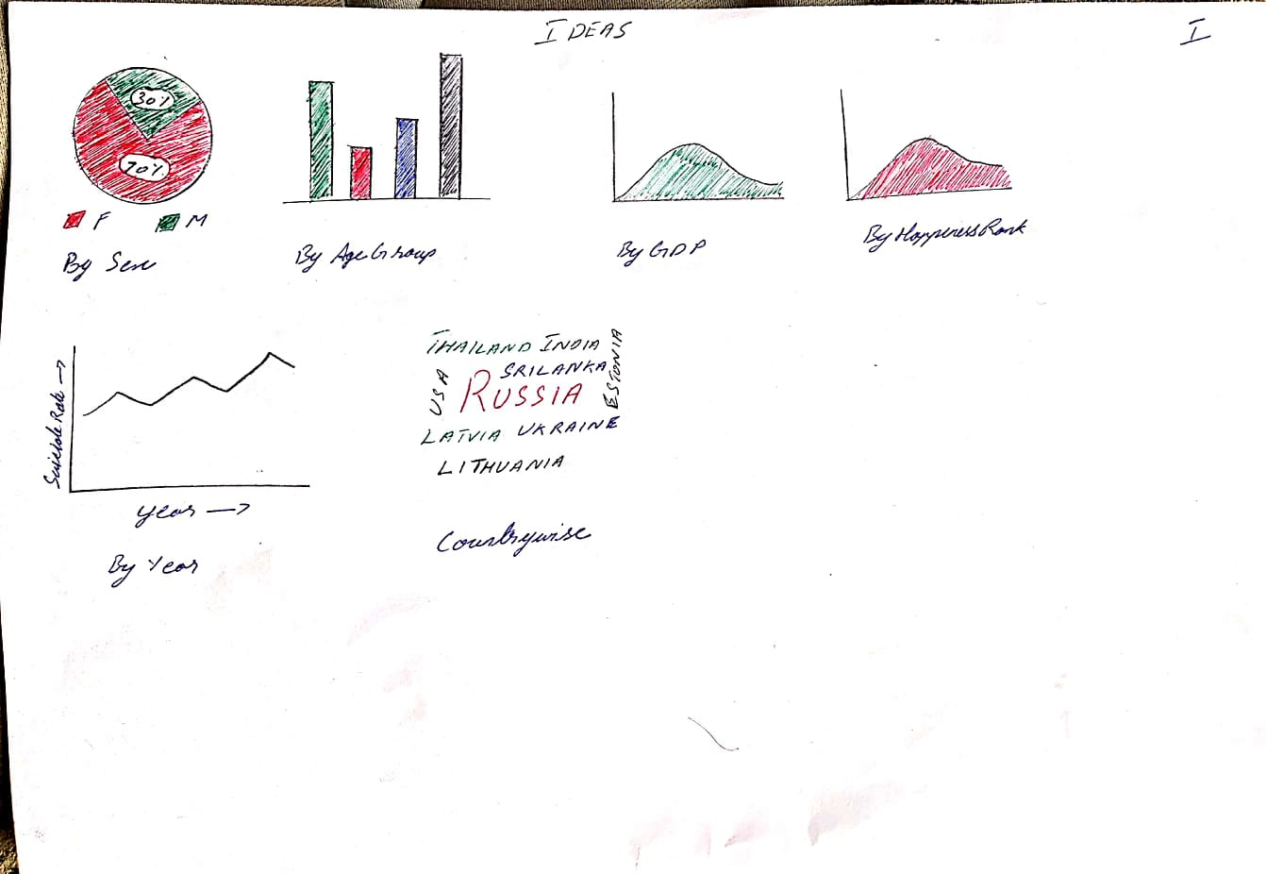

Slide 5
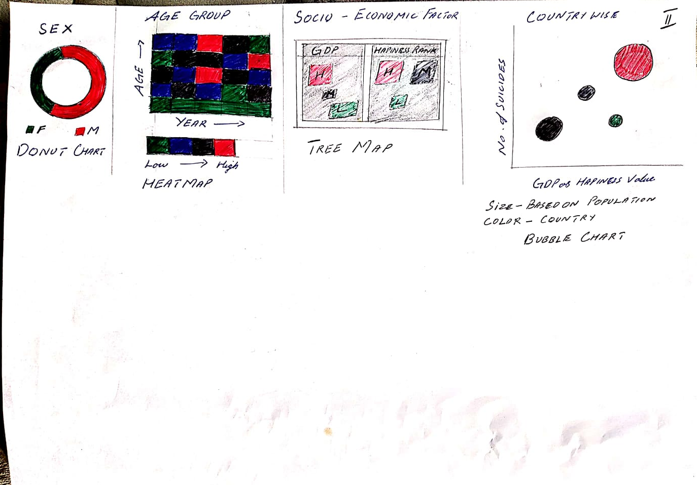

Slide 6
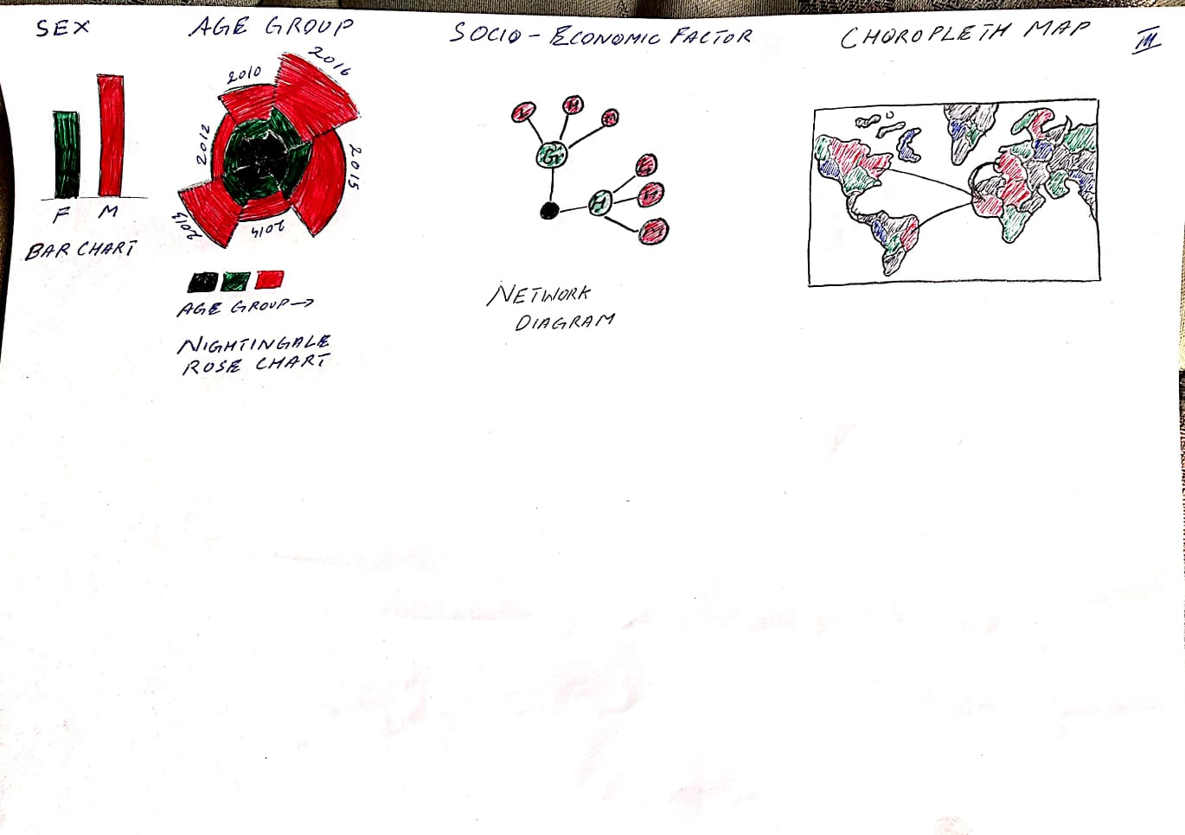

Slide 7
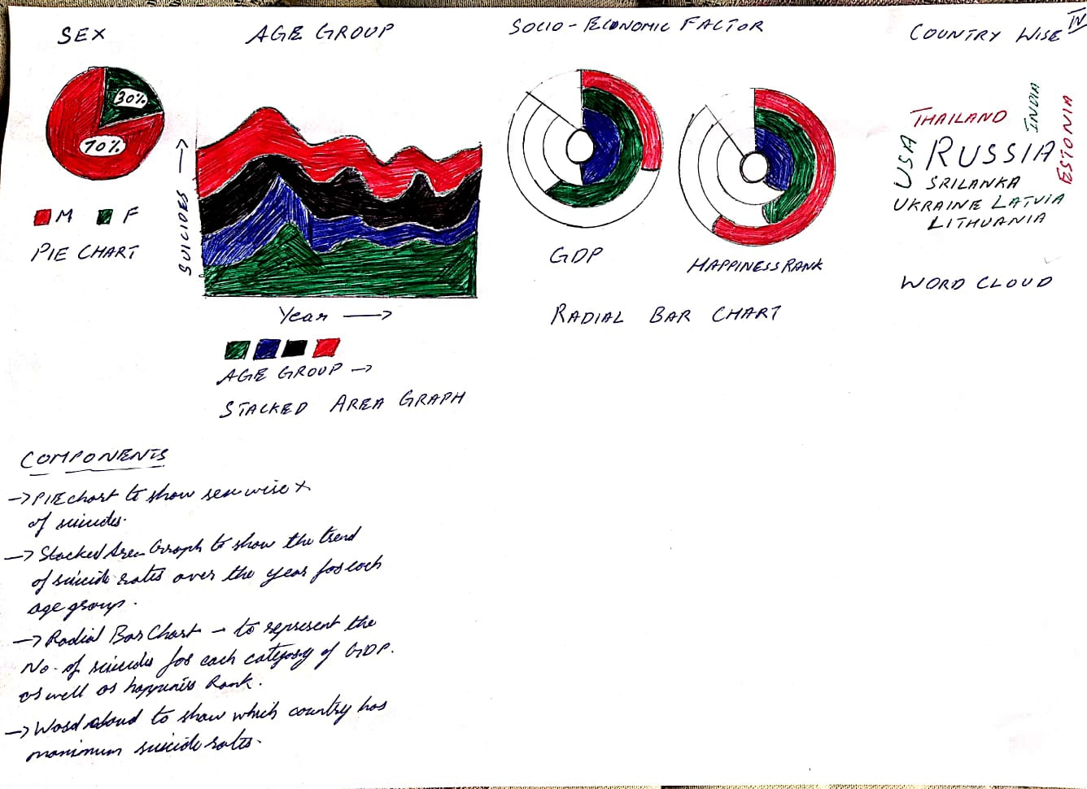

Slide 8
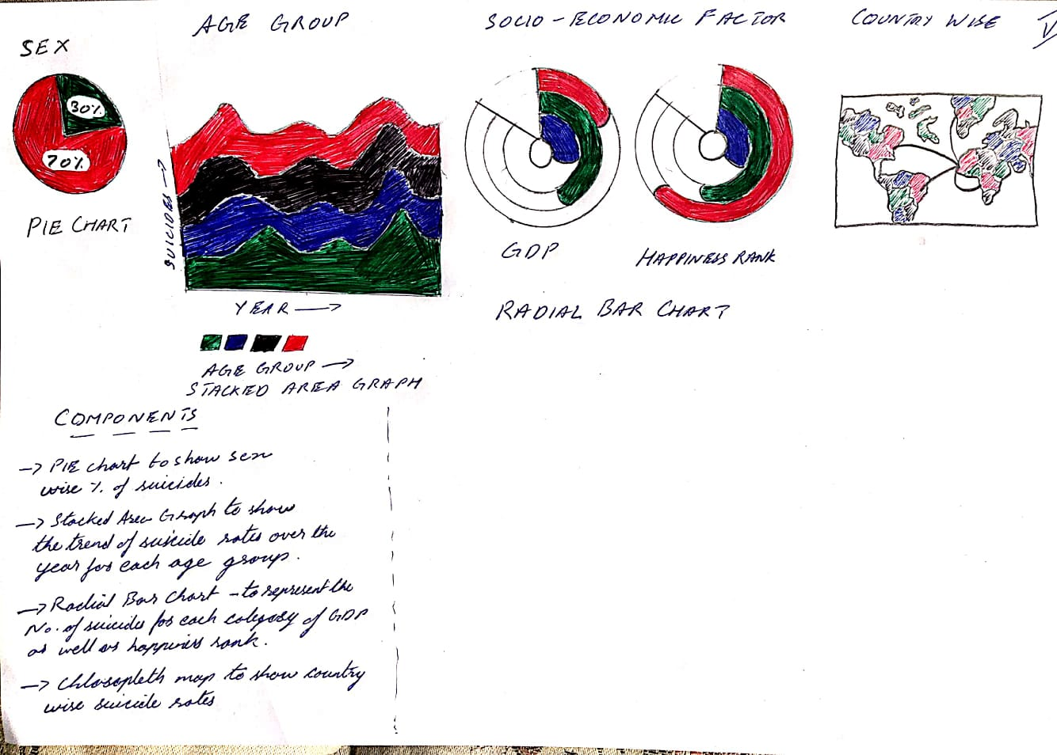

Slide 9
implementation
Will be done mostly using D3

Slide 10
Thank You

